Slide 1



NexGen
Management Update
November 12, 2004

Slide 2
Highlights

Slide 3
Strategy Headline
Strategy
Market Trends,
Client Needs,
Company Vision
Product Line Evolution
Commercialization
Strategy
Technical
Strategy
Marketing
Strategy
Operations
Strategy
Financial
Strategy
Partnering Strategy

Slide 4
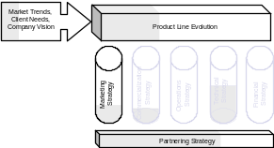
Focused on Business Planning
Product Management
Highlights
Worked with engineering to link key capabilities to architectural components to help prioritize product planning efforts
Began de-scoping the product plans, based on constraints for 2005
Established a process for reviewing overall investments planned for next year and determining the level of CODF alignment required
Defined five levels of partnership with Acxiom, working towards master agreements for each
Conducted initial product orientation training on Blackbird with BPM sales teams
November | December | January | Q1 ‘05
Blackbird Begin pilot | Blackbird Support pilot Manage Gen III requirements and development | Blackbird Begin testing for Gen III Prepare for RCPG summit | Blackbird Product launch (at risk – no committed timeline from Acxiom)
Roadmap Complete initial product definitions to inc. within the overall bus plan. Review current client deliverables | Roadmap Begin staffing up Begin fleshing out details for many of the high priority products Plan client VOC Align with other depts. | Roadmap Define an initial dashboard describing level 1 monitoring Map one client into the standard for concept validation | Roadmap Conduct client VOC sessions and begin analyzing feedback
Updated bi-weekly

Slide 5
Commercialization Headline
Commercialization
Market Trends,
Client Needs,
Company Vision
Product Line Evolution
Technical
Commercialization
Strategy
Strategy
Strategy
Strategy
Marketing
Strategy
Financial
Operations
Highlights
Partnering Strategy
November | December | January | Q1 ‘05
Updated bi-weekly

Slide 6
Focused on designing highly reliable and low-cost processes
Operations
Market Trends,
Client Needs,
Company Vision
Product Line Evolution
Technical
Commercialization
Strategy
Strategy
Strategy
Strategy
Marketing
Strategy
Financial
Operations
Highlights
Partnering Strategy
November | December | January | Q1 ‘05
Blackbird Begin pilot | Blackbird Support pilot | Blackbird | Blackbird Product launch
Roadmap | Roadmap | Roadmap | Roadmap
Updated bi-weekly

Slide 7
Completing POC Business Cases and Blackbird Gen 2
Engineering
Market Trends,
Client Needs,
Company Vision
Product Line Evolution
Technical
Commercialization
Strategy
Strategy
Strategy
Strategy
Marketing
Strategy
Financial
Operations
Highlights
Global DI on hold pending senior management direction
NAQC process updated to include CODF Alignment assessment
Business Rules - Iteration 2 to commence 11/16
Proposal for OMS Release 0.1 (Blackbird Gen 3) approved by Chief Architect
Development Pod (GRID) on-line, production grid requirements being developed
Partnering Strategy
November | December | January | Q1 ‘05
Platform AS 4.2.5 Release RPM 4.2 release Office Viewer 1.1 Release |  | Data Productionization / OLAP Server Iteration 3 | BPM Pilot Office Viewer Pilot RPM Access to Daily Data AS Windham Release RPM Cheetah Release Plus Suite 2.0
Data Integration (DI) Integrated Product Roadmap Integrated Architectural View | Integrated Product Roadmap Integrated Architectural View |  | Census Daily Data
Configuration Completed OMS Business Case |  |  | Interim Order Mgmt Interface
Business Rules Completed Rules Business Case |  |  | Initial Rules Framework Daily Data QC
Data Management FDW Hybrid Business Case Dim Mgmt Business Case Blackbird Gen 2 |  |  | Initial FDW DCS for Daily Data Data Mart Framework Data Mart Access via RPM Initial Data Scoping
Updated bi-weekly

Slide 8
Finalizing General Strategies
Mainframe Retirement and Data Center Migration
Market Trends,
Client Needs,
Company Vision
Product Line Evolution
Technical
Commercialization
Strategy
Strategy
Strategy
Strategy
Marketing
Strategy
Financial
Operations
Highlights
Completed 1st draft of MF Retirement Strategy document – overview provided for Europe
Completed matching SAR information to SMF
Partnering Strategy
November | December | January | Q1 ‘05
Mainframe Retirement Complete General M/F Retirement Strategy | Complete Retirement Strategy – 1st Application | Complete Retirement Strategy – 2nd Application | Complete Retirement Strategy – 3rd Application Migrate M/F to Conway Modify M/F for 1st Application
Data Center Migration Submit C/S and M/F Business Cases | Complete Environment Design/Architect Submit Network Business Case Order Network Equipment |  | Complete M/F Environment Complete Data Migration
Updated bi-weekly

Slide 9
Developing business plan and projections
Financials
Market Trends,
Client Needs,
Company Vision
Product Line Evolution
Technical
Commercialization
Strategy
Strategy
Strategy
Strategy
Marketing
Strategy
Financial
Operations
Highlights
Partnering Strategy
November | December | January | Q1 ‘05
Business Plan 2005 Budgets CODF POC Business Cases
Updated bi-weekly

Slide 10
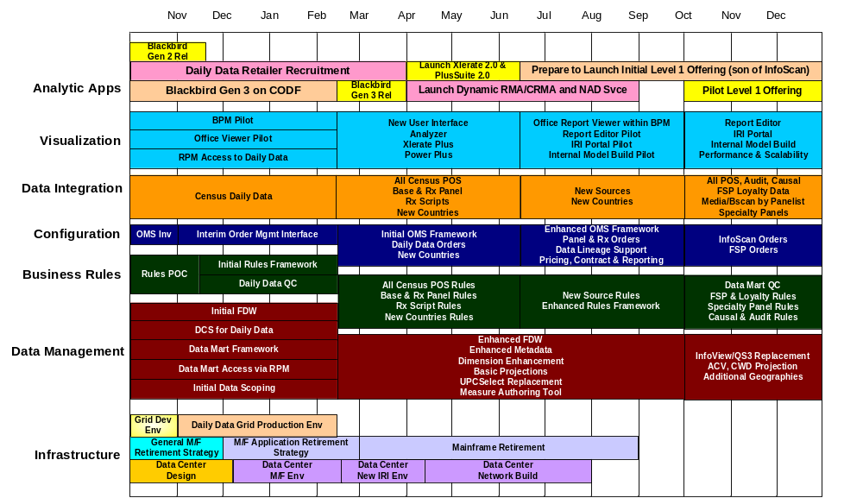
NexGen – Timeline

Slide 11
Milestones Report

Slide 12
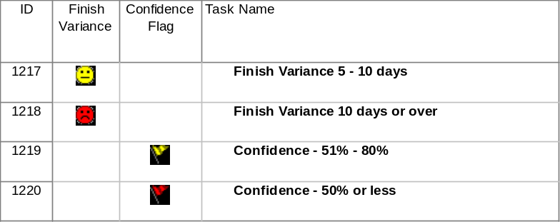
Horizontal Layers
  Analytic Apps: Daily Data (Blackbird Gen 2 & 3)
  Visualization Tools: AS & Data Integration/Validation, Data Visualization, Performance & Scalability
  Configuration Tools: Order Management
  Business Models & Rules: Business Rules, ILOG Plug-in
  Data / Data Management: Data Cleansing & Scrubbing, ODS/DW, Dimensional Management, Data Mart, Metadata
  Infrastructure: Base Grid, Infrastructure Planning, Mainframe Retirement, Data Center Migration
Legend to indicators
Notes:
Copyright © Information Resources, Inc. 2004. Confidential and proprietary.

Slide 13
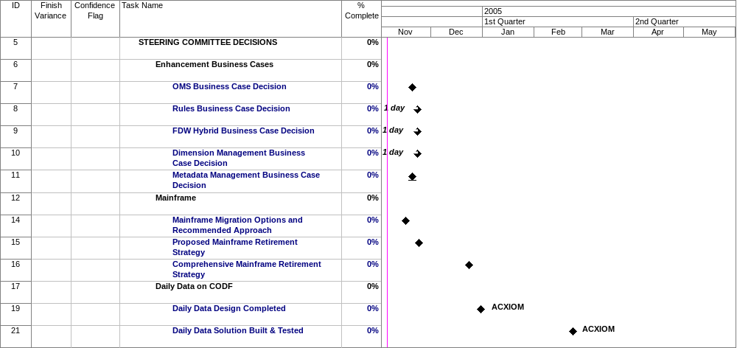
Steering Committee Decisions
Notes:
Copyright © Information Resources, Inc. 2004. Confidential and proprietary.

Slide 14
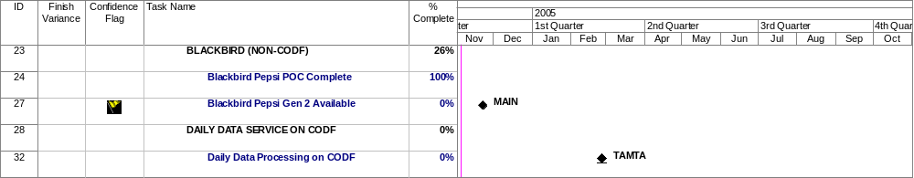
Analytic Apps - Milestones
Notes:
Copyright © Information Resources, Inc. 2004. Confidential and proprietary.

Slide 15
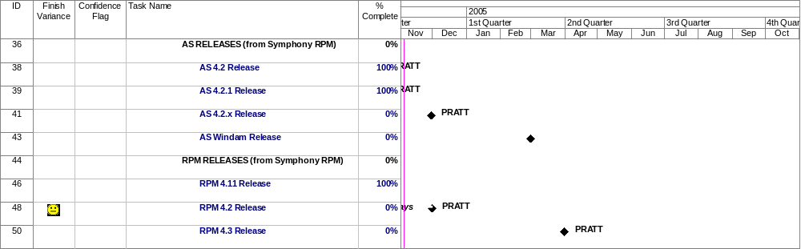
Visualization Tools – Symphony Milestones
Notes:
Copyright © Information Resources, Inc. 2004. Confidential and proprietary.

Slide 16
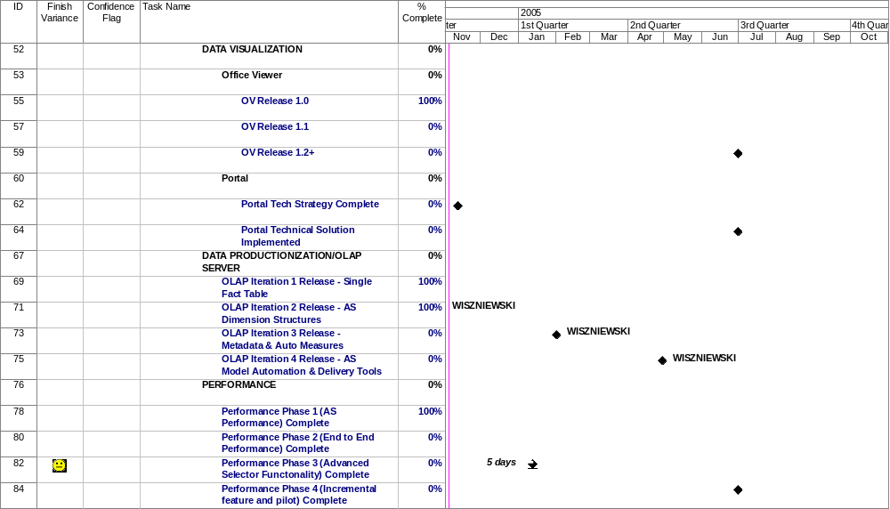
Visualization Tools – IRI Milestones
Notes:
Copyright © Information Resources, Inc. 2004. Confidential and proprietary.

Slide 17
Configuration Tools - Milestones
OMS being re-planned
Notes:
Copyright © Information Resources, Inc. 2004. Confidential and proprietary.

Slide 18
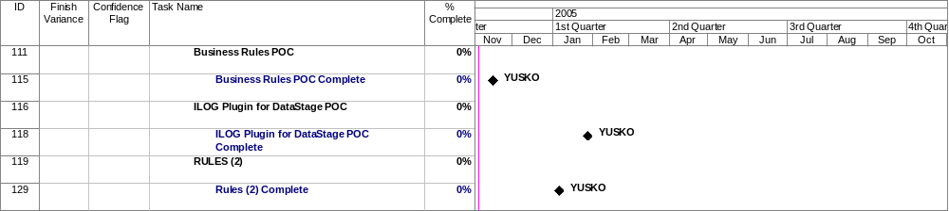
Business Models and Rules - Milestones
Notes:
Copyright © Information Resources, Inc. 2004. Confidential and proprietary.

Slide 19
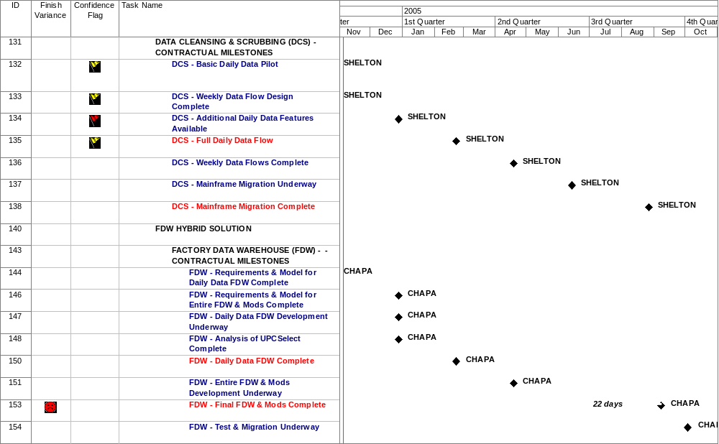
DCS & FDW– Contractual Milestones
Notes:
Copyright © Information Resources, Inc. 2004. Confidential and proprietary.

Slide 20
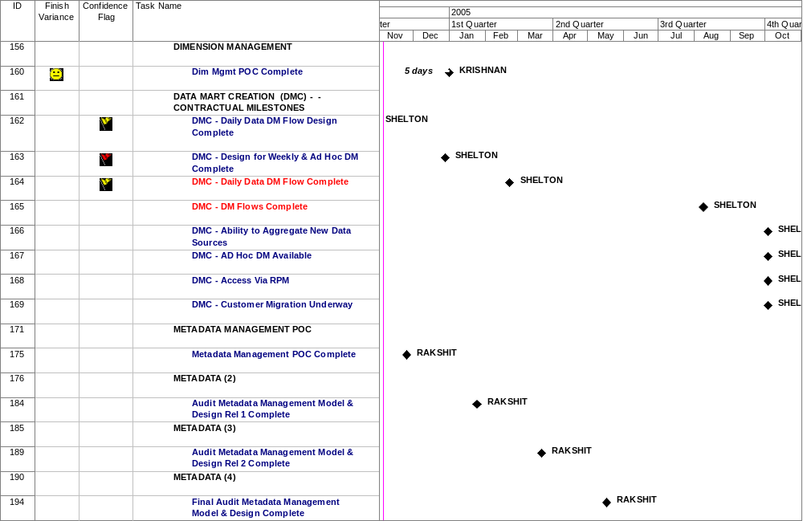
Dim Mgmt, Datamart & Metadata - Milestones

Slide 21
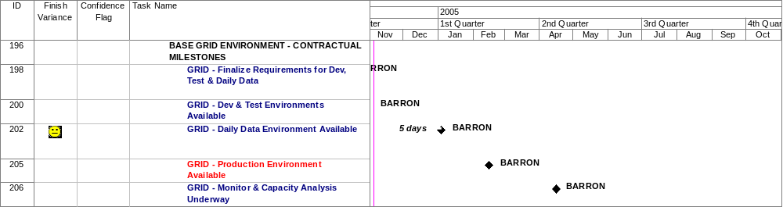
Infrastructure – Contractual Grid Milestones

Slide 22
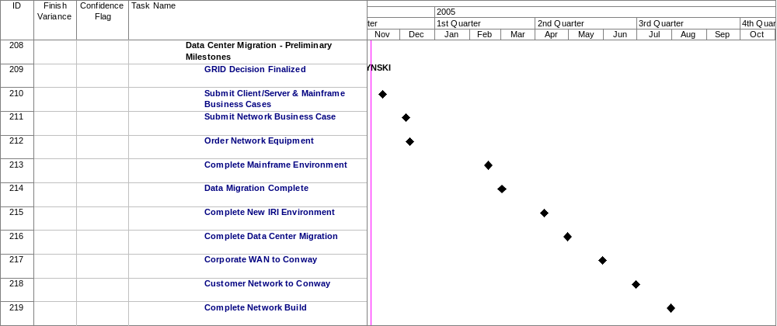
Infrastructure – Data Center Migration Milestones

Slide 23
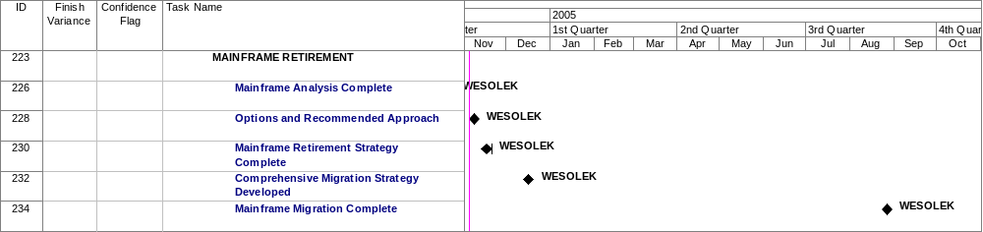
Infrastructure – Mainframe Retirement Milestones

